Slide 1
Software Architecture and Design
Software Testing
Dr. Carlos Eduardo da Silva (c.dasilva@shu.ac.uk)
Department of Computing
College of Business, Technology and Engineering
Sheffield Hallam University

Slide 2
Plan
Revisiting software testing
The role of Debugging
Unit testing
Testing APIs with Postman
Testing the user interface using Selenium

Slide 3
Testing revisited

Slide 4
What is the result of
var sum = 1;
for (let i = 0; i <= 4; i++);
{
sum = sum + 1;
console.log(sum);
}
console.log("the result is: " + sum);
console.log("Double result: " + sum+sum);
1

Slide 5
What is the result of
var sum = 1;
for (let i = 0; i <= 4; i++);
{
sum = sum + 1;
console.log(sum);
}
console.log("the result is: " + sum);
console.log("Double result: " + sum+sum);
1
var sum = 1;
for (let i = 0; i <= 4; i++)
{
sum = sum + 1;
console.log(sum);
}
console.log("the result is: " + sum);
console.log("Double result: " + sum+sum);
2

Slide 6
What is the result of
var sum = 1;
for (let i = 0; i <= 4; i++);
{
sum = sum + 1;
console.log(sum);
}
console.log("the result is: " + sum);
console.log("Double result: " + sum+sum);
1
var sum = 1;
for (let i = 0; i <= 4; i++)
{
sum = sum + 1;
console.log(sum);
}
console.log("the result is: " + sum);
console.log("Double result: " + sum+sum);
2
var sum = 1.0;
for (let i = 0; i <= 4; i++)
{
sum = sum + 1;
console.log(sum);
}
console.log("the result is: " + sum);
console.log("Double result: " + sum+sum);
3

Slide 7
What is the result of
var sum = 1;
for (let i = 0; i <= 4; i++);
{
sum = sum + 1;
console.log(sum);
}
console.log("the result is: " + sum);
console.log("Double result: " + sum+sum);
1
var sum = 1;
for (let i = 0; i <= 4; i++)
{
sum = sum + 1;
console.log(sum);
}
console.log("the result is: " + sum);
console.log("Double result: " + sum+sum);
2
var sum = 1.0;
for (let i = 0; i <= 4; i++)
{
sum = sum + 1;
console.log(sum);
}
console.log("the result is: " + sum);
console.log("Double result: " + sum+sum);
3
var sum = 1.0;
for (let i = 0; i <= 4; i++)
{
sum = sum + 0.1;
console.log(sum);
}
console.log("the result is: " + sum);
console.log("Double result: " + sum+sum);
4

Slide 8
What is the result of
2
the result is: 2
Double result: 22
1
2
3
4
5
6
the result is: 6
Double result: 66
2
2
3
4
5
6
the result is: 6
Double result: 66
3
1.1
1.2000000000000002
1.3000000000000003
1.4000000000000004
1.5000000000000004
the result is: 1.5000000000000004
Double result: 1.50000000000000041.5000000000000004
4

Slide 9
How many have you got right?
0
1
2
3
4

Slide 10
The Basic Concepts
“A system is an entity that interacts with an environment (e.g., other systems, hardwares, humans, etc) and implements one or more functions in order to deliver services”
… described by a (functional/non-functional) specification
A failure (the wrong provision of services) is the external manifestation of an error which in turn is caused by a fault
A bug is a fault in the program usually activated under particular circumstances
Most bugs are due to developers' errors in source code or design
A. Avizienis, J. . -C. Laprie, B. Randell and C. Landwehr, "Basic concepts and taxonomy of dependable and secure computing," in IEEE Transactions on Dependable and Secure Computing, vol. 1, no. 1, pp. 11-33, Jan.-March 2004, doi: 10.1109/TDSC.2004.2.

Slide 11
Faults, Errors, Failures
Software systems are susceptible to many types of threats in its life
Some of these happen during development/design-time
Requirements are specified incorrectly
Developers make mistakes
Use the wrong algorithm/data structure/variable name
Some are caught by the compiler
Some happen in production/use/production
The server runs too slowly, the network has insufficient bandwidth
The admin used the wrong command
A third party service produced the wrong output
Logical errors

Slide 12
Types of fault | Failure
Algorithmic faults | A computer algorithm does not produce the desired output
Computation and precision faults | The implementation of a formula is wrong or does not compute the result to the degree of precision that is required
Documentation faults | The documentation does not match what the program actually does
Stress or overload faults | Data structures (such as queues, arrays, etc.) are filled past their specified capacity
Capacity or boundary faults | The system’s performance becomes unacceptable as system activity reaches its specified limit
Timing and coordination faults | The code that coordinates events is inadequate. This can occur in both concurrent and sequential code
Throughput or performance faults | The system does not perform at the speed prescribed by the requirements
Recovery faults | When a failure is encountered, the system does not behave as the designer expects or as the customer requires

Slide 13
Testing cannot prove the absence of errors
Notes:
https://astqb.org/istqb-foundation-level-seven-testing-principles/

Slide 14
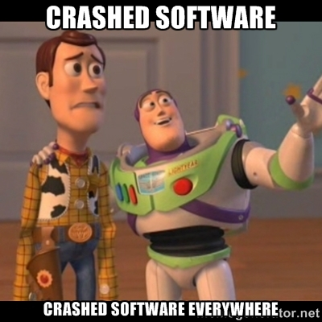
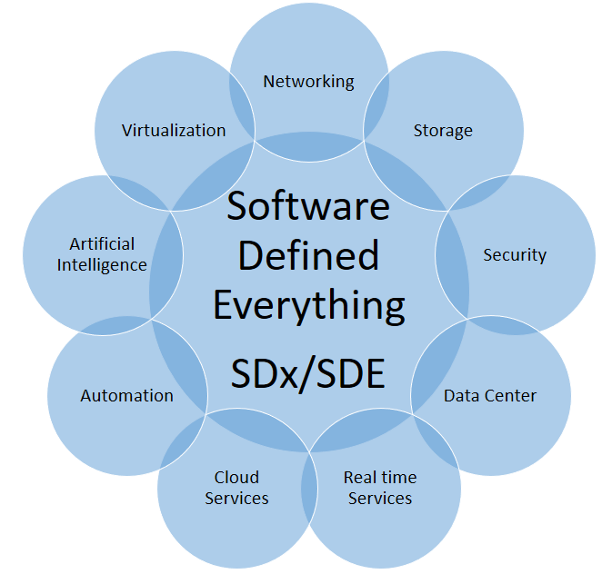
So, why bother?

Slide 15
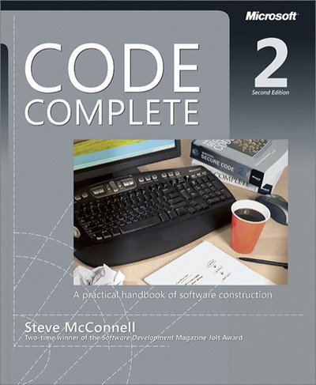
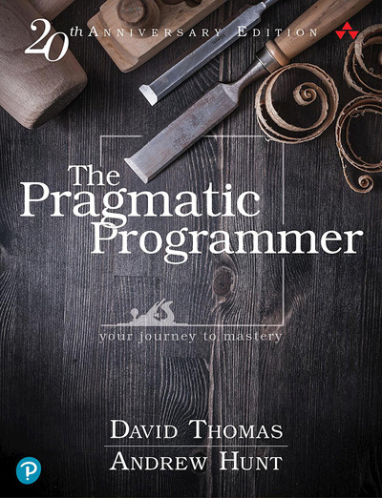
Prevention vs Detection
Reduce probability of faults
Software engineering techniques
encapsulation
Improve chances of detection
Modularisation and documentation
Develop techniques for detection
Compiler not always helpful
Reading suggestions

Slide 16
What is Testing?
Testing is the process of finding and understanding problems in your systems and software
Looking for
Existence of errors
Source of errors
Debugging
Looking for the source of the error (the fault)
“Error manifestation can happen at some distance from its source (fault)”

Slide 17
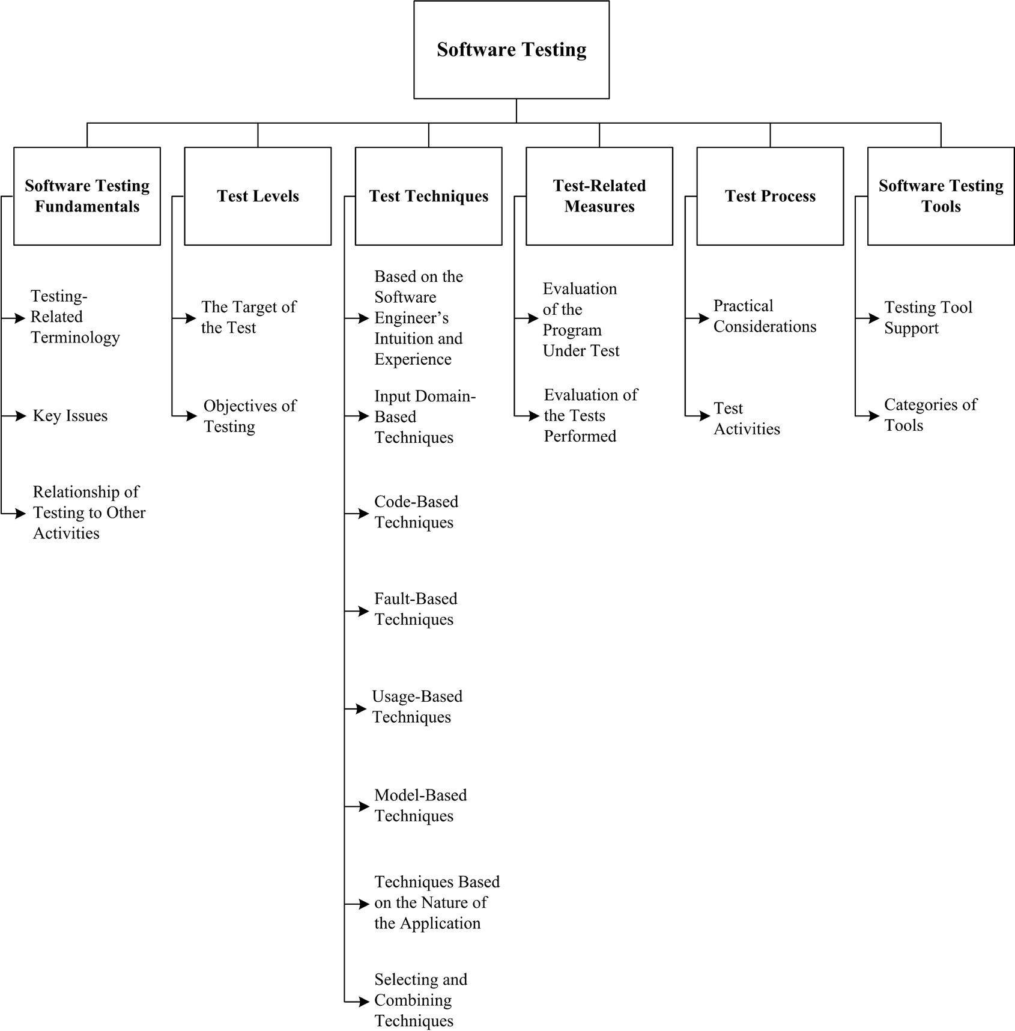

Software Testing is a huge area
Some examples of topics
Reviews of specifications and user-stories
Debugging, Code reviews
Unit, integration, system
Acceptance, installation, alpha/beta, regression, performance
User-interface testing
…

Slide 18
Automation
Manually testing your software can be effective but it is difficult to accurately reproduce both
Your tests
The effects that they have throughout the system
If you can automate your tests then you can
Run them repeatedly without additional effort
Run them quickly at no cost
Make them be part of your build process

Slide 19
Regressions
As you develop your software you make changes that can impact existing production versions
New features are added
Existing code is modified
Remember there is a lot of non-determinism in modern distributed software
Regression testing is the process of running tests that are known to pass against the new version of the software
Did you break anything that was previously working?
Does the software work on new devices and platforms?

Slide 20
Debugging

Slide 21
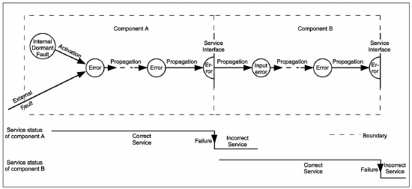
“Error manifestation can happen at some distance from its source (fault)”

Slide 22
Is this really testing?
Debugging helps you to
Find problems in your code
Understand your code
Get to know other people's code
You'll make calls into code that your colleagues wrote
When debugging, you'll be
Testing whether the code works properly
Finding problems before you deploy
Looking for ways to refactor and improve your code

Slide 23
Debugging Techniques
Print statements and assertions
Quick and dirty
Low cost
Remember not build the final version with assertions switched on!
Log frameworks practices
Debuggers
Often built into your development environment
Let you control the execution of the code
Breakpoints
Watches
Let you inspect
Program state (variables)
Stack and call sequence

Slide 24
Unit tests

Slide 25
What should we test?
A “unit” is a software entity/element that works in isolation
An individual program, function, procedure, method which may belong to a super, abstract or child class
A class is a good granularity
Usually done during development
With support of debugging tools
Cheaper to fix a defect earlier in the development process
Incremental creation of test sets

Slide 26
What should we test?
Understand the unit contract
What is should be doing
Look for violations
Positive tests: we expect it will work
Negative tests: we expect it will fail
Expecting an exception of error signal/message
Test the limits
Zero, one, full
E.g., search an empty collection
Good software design makes it easier to find and test units of code
SOLID
GRASP

Slide 27
GRASP
General Responsibility Assignment Software Patterns
Guidelines for assigning responsibility to classes and objects
Includes patterns for
Receiving and handling system events (controllers)
The creation of objects (factories, builders etc.)
Highly cohesive classes
Low coupling between classes
Delegation of responsibilities
Protecting type variants through interfaces and polymorphism
The use of reusable services to connect and support domain objects
Using indirection to reduce coupling (eg controllers in MVC)

Slide 28
SOLID
Single responsibility
A class should have only a single responsibility
Open/closed principle
Software entities should be open for extension, but closed for modification
Liskov substitution principle
Objects in a program should be replaceable with instances of their subtypes without altering the correctness of that program
Interface segregation
Many client-specific interfaces are better than one general-purpose interface
Dependency inversion principle
Depend upon abstractions, not concrete implementations

Slide 29
Using a framework
There are lots of frameworks that support unit testing
As ever with node there are lots of NPM packages
Perhaps the leader of the node pack is Mocha
A feature-rich node package
It builds on the idea of assertions
Tests are written using descriptive language
var assert = require('assert');
describe('Array', function() {
describe('#indexOf()', function() {
it('should return -1 when the value is not present', function() {
assert.equal([1,2,3].indexOf(4), -1);
});
});
});

Slide 30
Mocha
Mocha supports a number of different assertion libraries
should.js, expect.js, chai, better-assert, unexpected
By default it uses JavaScript's built-in assertions
The framework is sufficiently flexible that it can also be used in a behaviour-driven development style
When testing asynchronous code
Execute the tests
Invoke the callback after the tests complete
Mocha will wait until the callback returns before completing the test
We’ll explore it in the tutorial session!

Slide 31
Testing API calls

Slide 32
Why do this?
You know your API works because
Your clients work
You can connect
The URLs “make sense” to you
But what about the edge-cases
Payloads
Parameters
Authentication
Sessions
The API is a mass of potential vulnerabilities
You need to test it properly

Slide 33
Using Postman
Perhaps the easiest way to test a Web API is to use Postman
It supports all HTTP verbs and payload types
Runs on all operating systems
Let’s you mock services
Produces neatly formatted reports
Automates your testing process
You can use it on any Web backend whether it is a coherent API or not

Slide 34
Driving from the user-interface

Slide 35
User experience
The user experience is complex
It contains at least the following
Ease of use
Familiarity
Responsiveness
Accuracy
Utility
Jesse James Garrett produced a nice chart of a UX stack
How do we test something that complicated?

Slide 36
Testing the experience
Users are asked to complete tasks while one or more of
Observed by a researcher
Filmed
Following a spoken-word protocol
Completing a diary
Having their interactions recorded
Analyse the results to see where they
Encounter problems
Experience confusion
Where more people encounter similar problems recommendations are made

Slide 37
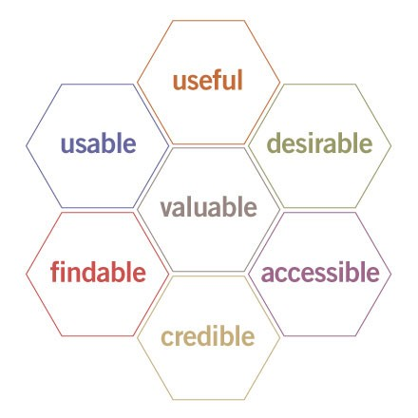
Honeycomb
Peter Morville and friends defined a honeycomb of things that to consider in testing a Web application
Notice how subjective these are
None of these are "technical"

Slide 38
Morville’s terms
Useful. As practitioners, we can’t be content to paint within the lines drawn by managers. We must have the courage and creativity to ask whether our products and systems are useful, and to apply our knowledge of craft + medium to define innovative solutions that are more useful.
Usable. Ease of use remains vital, and yet the interface-centered methods and perspectives of human-computer interaction do not address all dimensions of web design. In short, usability is necessary but not sufficient.
Desirable. Our quest for efficiency must be tempered by an appreciation for the power and value of image, identity, brand, and other elements of emotional design.

Slide 39
Morville’s terms
Findable. We must strive to design navigable web sites and locatable objects, so users can find what they need.
Accessible. Just as our buildings have elevators and ramps, our web sites should be accessible to people with disabilities (more than 10% of the population). Today, it’s good business and the ethical thing to do. Eventually, it will become the law.
Credible. Thanks to the Web Credibility Project, we’re beginning to understand the design elements that influence whether users trust and believe what we tell them.
Valuable. Our sites must deliver value to our sponsors. For non-profits, the user experience must advance the mission. With for-profits, it must contribute to the bottom line and improve customer satisfaction.

Slide 40
Using selenium
We need testing of the user-interface to be
Accurate
Fast
Reproducible
Meaningful
To do this we can
Create scripts that testers follow
Use a tool to drive the UI
Selenium is the best-known tool for automating UI testing
Runs in many browsers and across platforms
Web driver lets you write OO-style scripts
IDE runs inside a browser and is much easier to use

Slide 41
Behaviour-driven development

Slide 42
Introduction
Automated testing is a vital part of the modern software development process
If done well it can reduce
The number of bugs in production code
The severity of those bugs that remain
Tests link nicely with user stories, use cases or personas
In dynamic languages such as JavaScript testing
Gives some of the reassurance one gets from a compiler
Ensures that the dynamic nature is controlled
Doesn’t enforce typing
Unit tests are (relatively) lightweight and simple
To write
To use

Slide 43
What is BDD
An agile process to aid software development encouraging a business perspective to the software project
An evolution of Test Driven Development (TDD)
write a “single” unit test describing an aspect of the program
run the test, which should fail because the program lacks that feature
write “just enough” code, the simplest possible, to make the test pass
“refactor” the code until it conforms to the simplicity criteria
repeat, “accumulating” unit tests over time
Misunderstandings about TDD were plenty
Where to start? What to test? What not to test? How much to test? ….

Slide 44
Behaviour-driven development
BDD improves communication between engineers and domain experts
It extends and refines Test Driven Development (TDD) and Acceptance Test Driven Development (ATDD)
Relates user story to business outcomes (“five why’s” principle)
Minimise “waste” by only implementing those behaviours that contribute to the business outcomes
Defines a single notation to describe behaviour
Applied from the higher to the lowest level of abstraction
ATDD brings different perspectives to the table, focusing of writing acceptance tests before implementing functionalities (a.k.a. Three amigos)

Slide 45
The problem
Software development is plagued by overwork
Wasted time and under-utilised resources
This is true for for both developers and domain experts
Communication is often the bottleneck to project progress
Developers can easily misunderstand what the business needs from its software
Domain experts misunderstand the capabilities of
Their technical team
Software and systems in general
“Can you make it more pink?”
Once a project is delayed it cannot easily get back on track
Mythical Man-Month by Fred Brookes
The Psychology of Computer Programming by Gerald Weinberg
Dreaming in Code by Scott Rosenberg

Slide 46
BDD to the rescue
All development work can be traced back directly to business objectives
Software development meets user need
Efficient prioritisation so that business-critical features are delivered first
Software design Matches existing needs and Supports future business needs
A common language ensures visibility to the project
All parties have a shared understanding of the project and can be involved in discussions
Improved quality code, automated tools
Reduces maintenance costs
Minimises project risk

Slide 47
How does it work?
Domain-specific language (DSL) is used to
Specify the expected behaviour of a component; and
Define expected outcomes
A DSL like this is near-natural language
Doesn’t have programming-style constructs
Has a rigid structure and a formal grammar
Behaviours are converted into test which can be run automatically
BDD requires dedicated tools
The DSL is typically expressed as the API of a framework
E.g., Jasmine, Cucumber, Chai, …

Slide 48
The BDD language
Title: Customer withdraws cash
As a customer,
I want to withdraw cash from an ATM,
so that I don't have to wait in line at the bank.
Given some initial context,
Describes the initial state
When an event occurs,
Describes the action performed by the actor
Then ensure some outcomes.
Describes the expected outcome
Resemblance to user stories and acceptance criteria are not mere coincidences.
Scenario: Account is in credit
Given the account is in credit
And the card is valid
And the dispenser contains cash
When the customer requests cash
Then ensure the account is debited
And ensure cash is dispensed
And ensure the card is returned
Scenario: Account is overdrawn past the overdraft limit
Given the account is overdrawn
And the card is valid
When the customer requests cash
Then ensure a rejection message is displayed
And ensure cash is not dispensed
And ensure the card is returned

Slide 49
Another example
Title: Returns and exchanges go to inventory.
As a store owner,
I want to add items back to inventory when they are returned or exchanged,
so that I can track inventory.
Scenario 1: Items returned for refund should be added to inventory.
Given that a customer previously bought a black sweater from me
and I have three black sweaters in inventory,
when they return the black sweater for a refund,
then I should have four black sweaters in inventory.
Scenario 2: Exchanged items should be returned to inventory.
Given that a customer previously bought a blue garment from me
and I have two blue garments in inventory
and three black garments in inventory,
when they exchange the blue garment for a black garment,
then I should have three blue garments in inventory
and two black garments in inventory.
* from https://en.wikipedia.org/wiki/Behavior-driven_development

Slide 50
The notion of ubiquitous language
The user-story identifies
A stakeholder
A business effect
Business value
Such a story describes several scenarios, each with
A precondition
A trigger
An expected outcome
But doesn’t say anything about how the functionality will be implemented
In the previous examples the ubiquitous language included terms such as
Stock
Replacement
Returns
As a [X]
X = person, role, stakeholder
I want [Y]
Y = some feature
so that [Z]
X = benefit or value of the feature
Given some initial context,
precondition
When an event occurs,
trigger
Then ensure some outcomes.
Expected outcome
Notes:
The terms you use in your user stories are relevant and must be used throughout the project to mean the same thing.

Slide 51
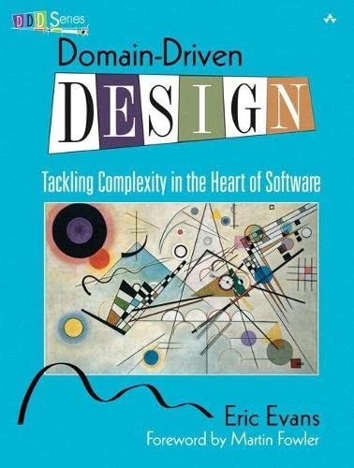
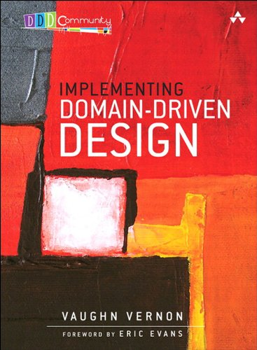
If you want to know more about it

Slide 52
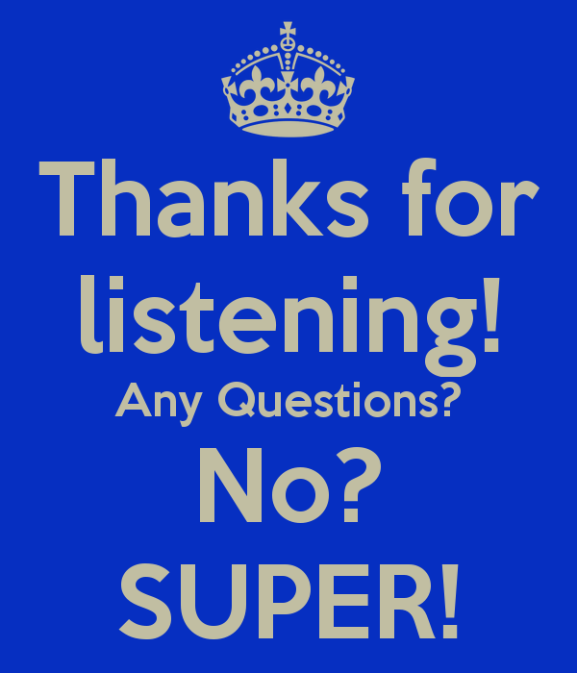

Slide 53
References and suggestions
https://mochajs.org/
https://www.chaijs.com/
https://www.digitalocean.com/community/tutorials/test-a-node-restful-api-with-mocha-and-chai
https://www.agilealliance.org/glossary/bdd
https://dannorth.net/introducing-bdd/

